Slide 1

VOLUNTEER
STARTER KIT
Animal Rescue
a 501c3 non-profit corporation
Check out
our MISSION &
ways YOU can help!

Slide 2
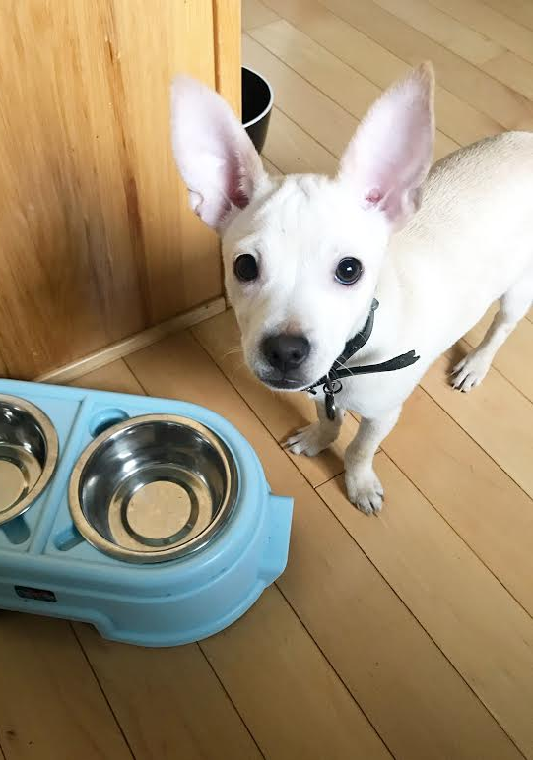
MOTLEY ZOO’S MISSION
To end the euthanization of healthy, adoptable pets through advocacy of rescue/ adoption and spay/ neuter
To end animal neglect, abuse & homelessness
To alleviate the suffering of animals
To improve the lives of animals everywhere
To elevate the status of animals in society

Slide 3
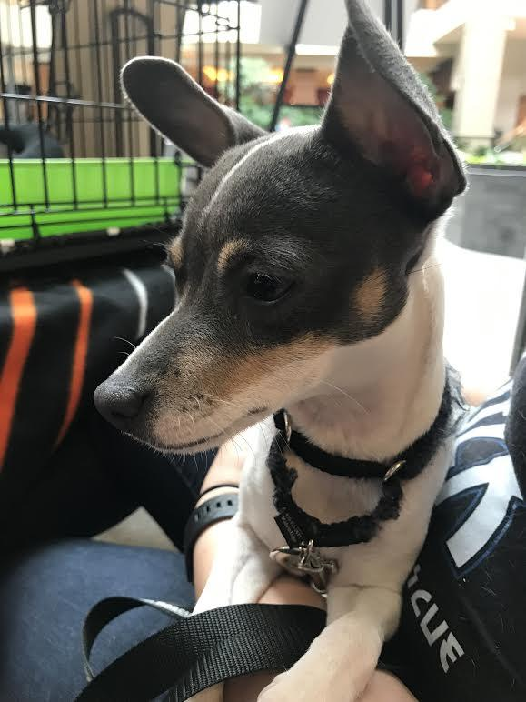
MOTLEY ZOO
ANIMAL RESCUE is...
Volunteer Run
Foster Based
No Kill
501c3 nonprofit
A RESCUE (vs a shelter)
WE are an animal’s LAST CHANCE.

Slide 4
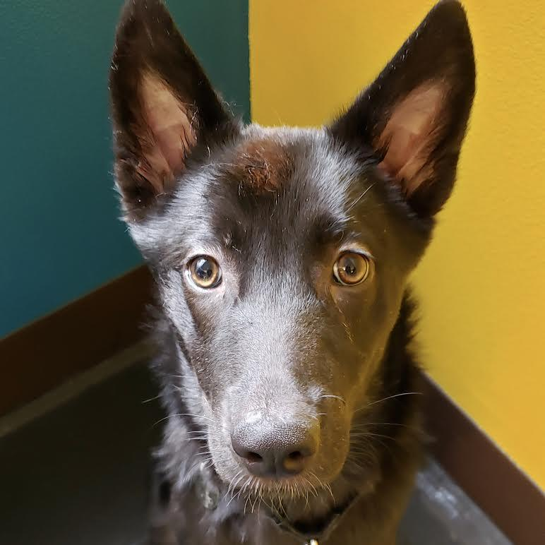
DID YOU KNOW….
6.5 million pets enter the shelter system each year...that’s 3.3 million dogs and 3.2 million cats.
1.5 million of those animals are euthanized- even healthy, adoptable ones.
This means nearly 9,000 animals lose their lives EVERY DAY.
HOW DOES THIS HAPPEN?

Slide 5
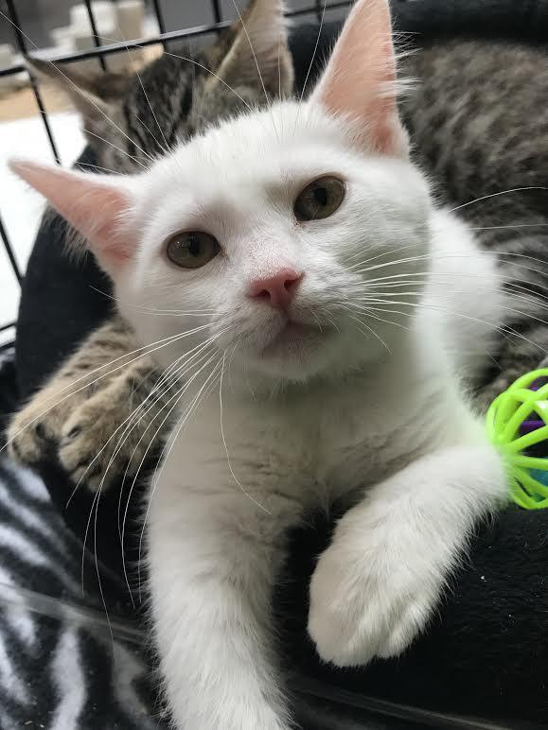
SO many Animal lives are lost because...
Shelters run out of room and must make space
There are not enough homes available to adopt each animal in need
The overarching issue causing this is pet overpopulation (unwanted animal births)
Believe it or not, there are still MANY people who do not spay / neuter their animals!
This is primarily because of a lack of affordability/ accessibility vs lack of interest or concern.

Slide 6
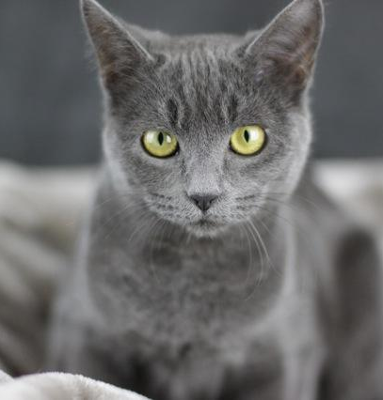
HOW MOTLEY ZOO strives to help!
Pet overpopulation is fixable.
Motley Zoo exists to combat unnecessary loss of life through collaboration with shelters and rescue, direct rescue/ rehoming, rehabilitation and education.
Responsible pet guardianship requires all pets are spayed and neutered and Motley Zoo ensures every animal we rescue and find a home for is safely altered.

Slide 7
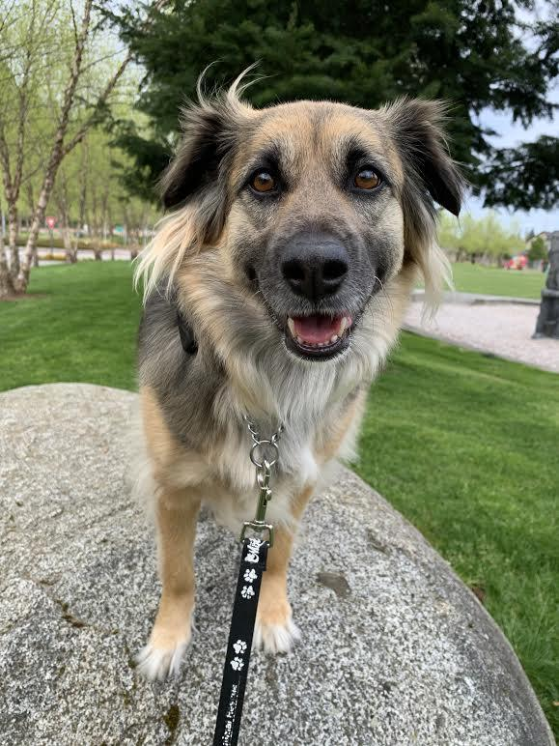
RESCUE VS. SHELTER
Libraries and bookstores both have books, but operate differently...so do rescues and shelters!
RESCUES usually don’t have facilities. Motley Zoo is the first of its kind!
As such, RESCUES animals are not in one place- they live in private homes, throughout the community
RESCUES do not euthanize for time or space constraints as a shelter might need to.
RESCUES can provide more individualized care and spend more on each animal.
RESCUES rely on retail veterinary services which are more costly than having an on-staff vet.
RESCUES are typically volunteer run and do not have staff available for on demand service.

Slide 8
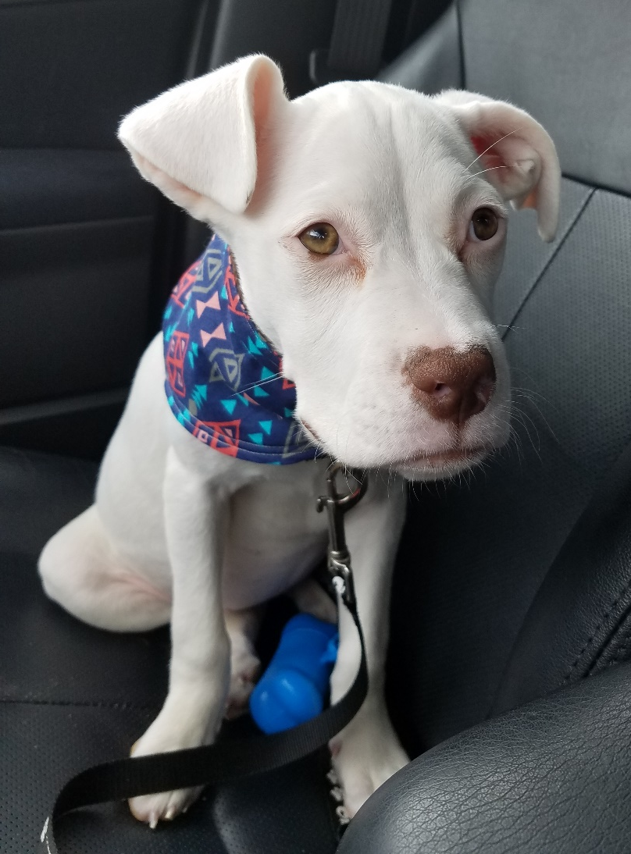
THEREFORE MZAR...
Supports various shelters as a second wave of response
Focuses on individual animals over large numbers or strays
Provides second chances for animals in need of costly medical and rehabilitative care and/or behavioral / emotional support
We are only as capable as our volunteer crew is able, willing and readily available. Meaning….
YOU determine what is possible for MZAR!

Slide 9
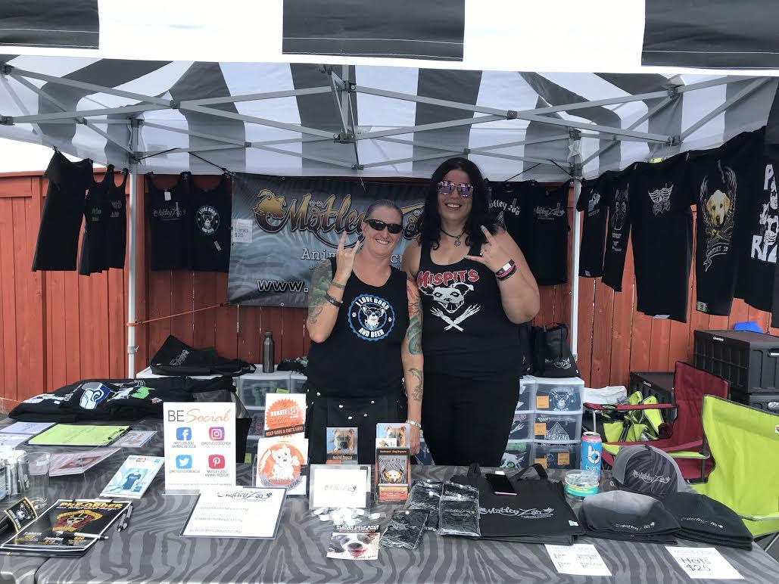
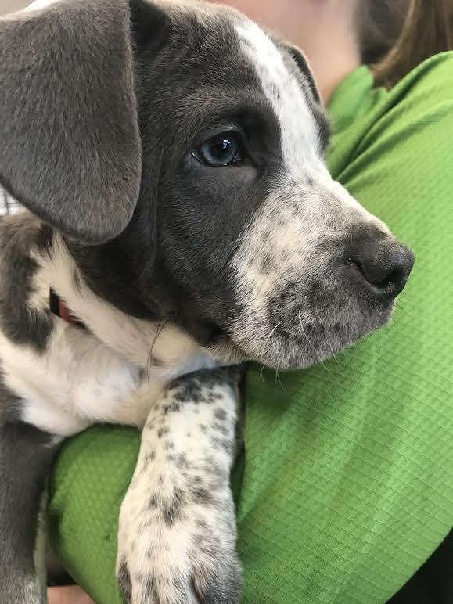
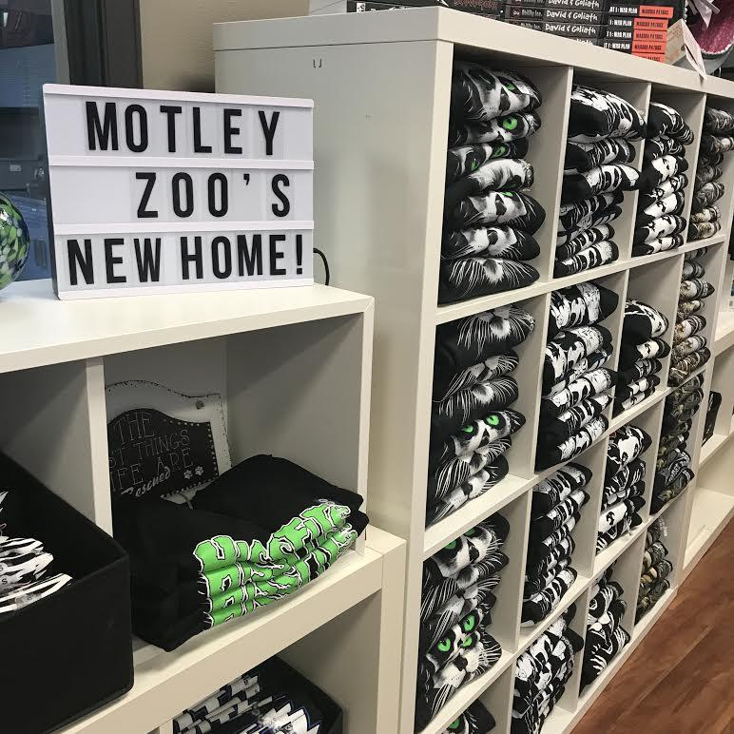
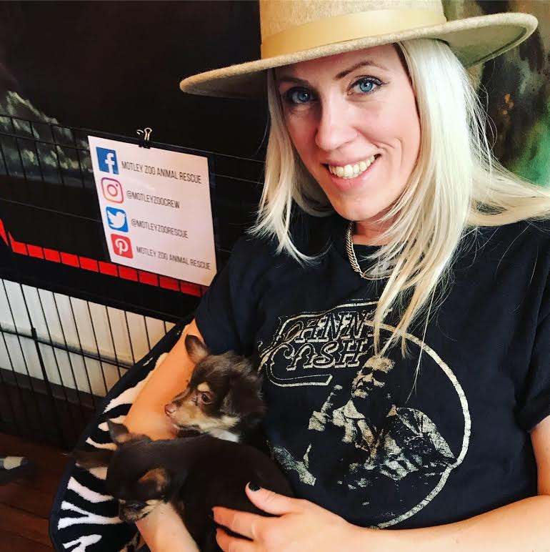
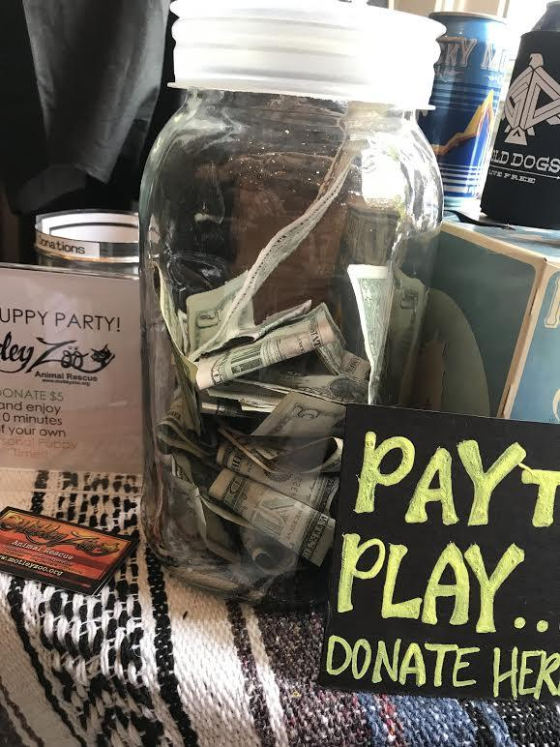
Ways YOU can
VOLUNTEER!
WORK at our
“MISSION CENTER STUDIO”
join the
THE EVENTS CREW
Become a FOSTER
FUNDRAISE and
GET CREATIVE!

Slide 10
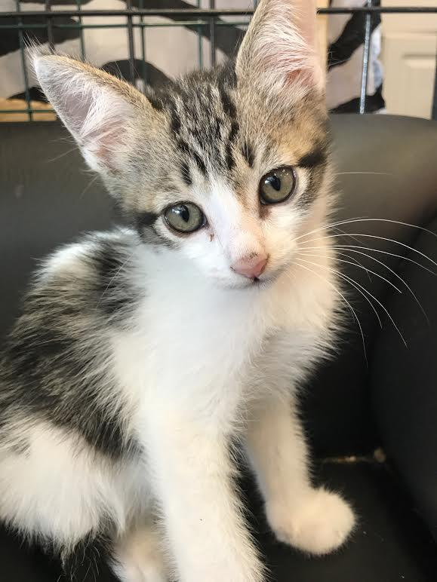
FOSTERING
Motley Zoo does not have a single location where our animals are housed.
Instead, we utilize private, volunteer foster homes where families like yours, care for our animals until an adoptive home is found.
Foster Families are a valuable team of volunteers, donating their time and effort to the animals.
We provide necessary food (when in good supply from donors), supplies, equipment and all vet care at no cost to the fosters.
Fosters provide love, structure, basic training, socialization, and transportation to vet clinics we work with.
Fosters are responsible for photos, videos and information about the animals’ personalities and needs- as well as for attending events that promote animals in person.

Slide 11
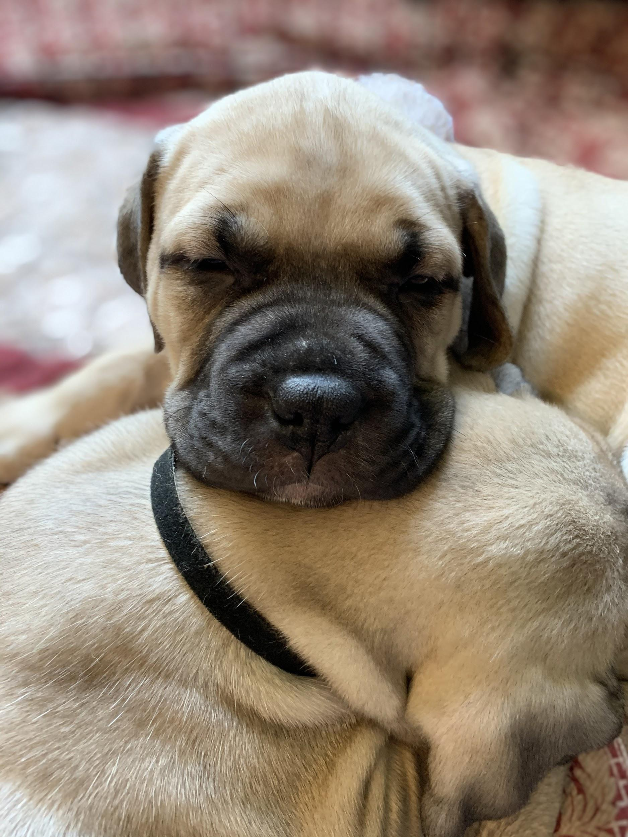
WHO CAN FOSTER?
Just about anyone can be a foster!
Young or old, people who work, have busy lives or lots of free time, have families & pets and/or live in houses, apartments or rentals, etc...YOU can foster!
  Dog fostering= Kids 5yrs+ Cat fostering= Kids 2yrs+
For people who have never had pets, it’s a great way to get some experience before adopting or to meet the best match in a furry friend
People who travel can foster in between trips!
Animals would prefer 10 minutes with you rather than spend any time in a shelter!

Slide 12
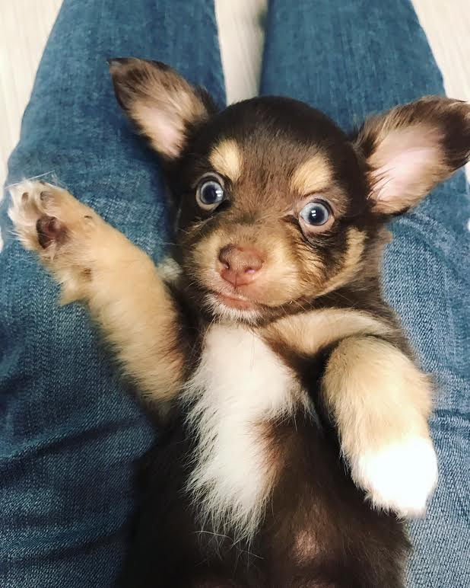
FOSTERING cont...
All animals coming into care undergo a strict 2-week in-home quarantine, so the animal can decompress and we can observe and treat any underlying health or behavioral issues.
Fostering lasts approximately 6-12 weeks, depending on the health of the animal and other factors.
Since MZAR takes in many types of animals, from healthy babies to those in need of little or extended care, each case requires a different set of expectations. Flexibility is key in animal rescue!
All cats in Foster homes must be kept INDOORS at all times, preferably in their own room.
ALL MZAR Foster Dogs are PROHIBITED from visiting Dog Parks and are NOT ALLOWED BONES for safety reasons!
FOSTER APPLICATION: foster@motleyzoo.org

Slide 13
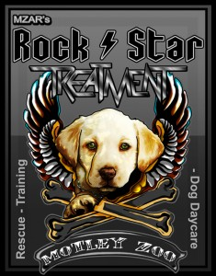
THE MISSION CENTER STUDIO
Motley Zoo operates a 7,000 sq ft. facility in Downtown Redmond called our “Mission Center Studio”.
This space includes:
The Main Stage- adoptions are performed, events are coordinated, and various other action occurs.
Rock Star Treatment a Dog Daycare and Training Facility. RST is a service-based fundraising effort where proceeds support MZAR’s Rescue Mission. Our services are available to anyone in the community, including adopters, foster families, volunteers and those who have obtained dogs elsewhere.
The Cat Lounge which operates like a foster home, provides temporary care until a cat finds a loving, permanent home.

Slide 14
THE MISSION CENTER STUDIO cont...
The MZAR Rock Star Shop which sells a variety of MZAR merch and various other animal supplies like leashes, collars, etc.
Backstage Access where supplies are stored and fosters can come get what they need.
Coming Soon: The Dog Lounge where our Adoptable Roadies can hang out and meet (day use only) by prospective families, similar to a shelter setting.

Slide 15
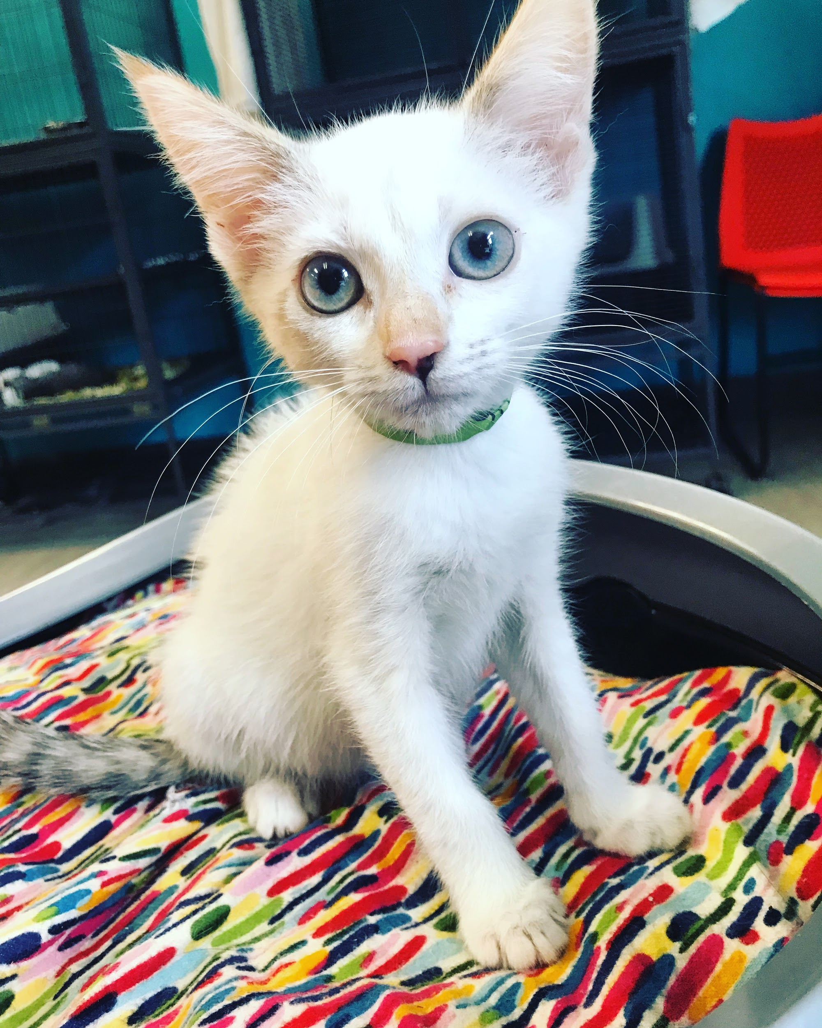
MISSION CENTER STUDIO cont...
Volunteer opportunities at the Mission Center Studio are plentiful and we are always looking for support!
We need YOU!
Regular volunteer shifts are available for those 18yrs+. Initial training includes 4 shifts for 4 weeks to learn the basics!
Duties include: managing dog play rooms, housekeeping, organizing donations & supplies, cat room, cat care, checking in and out daycare clients, laundry, selling merch, and other general daily tasks.
VOLUNTEER APPLICATION: volunteer@motleyzoo.org

Slide 16
MOTLEY ZOO EVENTS!
Motley Zoo depends upon our Community Outreach Crew (YOU!) to get out into the community and share our mission!
In Person (COVID dependent) Events:
Meet & Greets- an opportunity (typically at Pet Stores) for adoptable animals to meet and interact with the public and potential adopters.
Merch Booths- we represent MZAR and sell T-shirts and merch at many concerts and festivals all over Seattle and the PNW. Volunteers help with transport, set-up, take-down and everything in between.
MZAR Pop-Ups- smaller scale events typically in support of a local business partnering with MZAR, showcasing a few animals.
Puppy Parties- individuals, larger businesses and corporations donate for a few hours of puppy and/or kitten interaction/ therapy!

Slide 17
EVENTS cont:
The Motley Zoo Events Crew looks for outgoing, dependable, committed volunteers, at least 18 years of age. Events are the face of our organization, and volunteers must to be eager to learn and advocate for the mission of our volunteer-driven animal rescue.
Events are FUN, but are also hard work and range in length of time anywhere from 3 hours (Meet & Greets) to 8 hours (concerts!)
Transportation to off-site events may be available, but is not guaranteed. Just ask if you need a ride!
Motley Zoo also hosts a few yearly on-site events at the Mission Center Studio.
THE EVENTS CREW: volunteer@motleyzoo.org

Slide 18
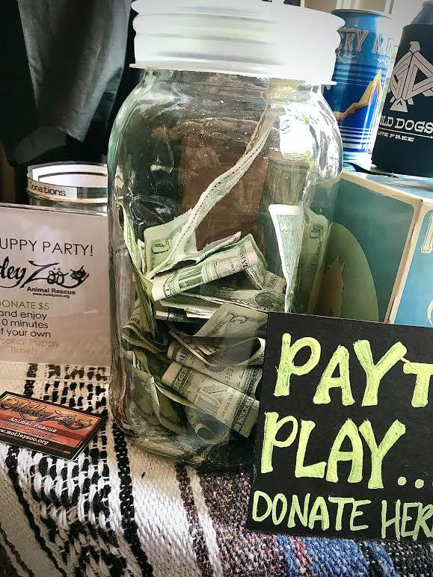
FUNDRAISING is FUN!
Adoption donations do not fully cover veterinary expenses. We spend more than $500/ animal and on average, $15,000/ mo which means:
The animals require additional support from the community.
DONORS ARE CRITICAL TO OUR MISSION
Motley Zoo seeks fundraising volunteers of all types. The most successful are those who are self-motivated and willing to coordinate an event or virtual fundraiser based upon their own personal skills and passion!
Using both yours and our social platforms, we will cross promote and help bring attention to our collective cause. Any funds generated by YOU on behalf of our animals go directly towards costly animal vet care!

Slide 19
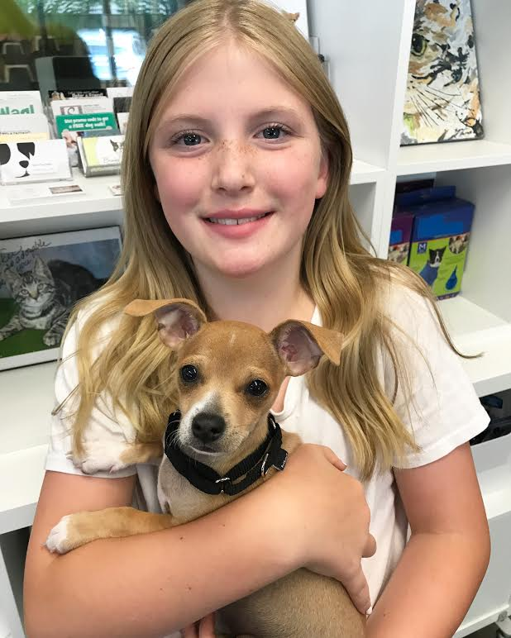
FUNDRAISING cont...
Motley Zoo depends upon our Community Outreach Crew to spread the word and generate support!
At Home and Virtually YOU can:
Share- spread the word about our Adoptable Roadies, campaigns, events and fundraising efforts on social media- or have your kids do sidewalk chalk art sharing our website!
Put on virtual events- start a fundraiser/ supply drive of your own by hosting a class/ meeting (ex: exercise, art, crafts, music), sell items you make, collect supplies for the animals and more...
“Bring rescue to work”- have our animals join your company’s virtual meetings, adding some cuteness to your work week!
Celebrate- support the animals through celebrations and special occasions like birthdays, anniversaries and more!

Slide 20
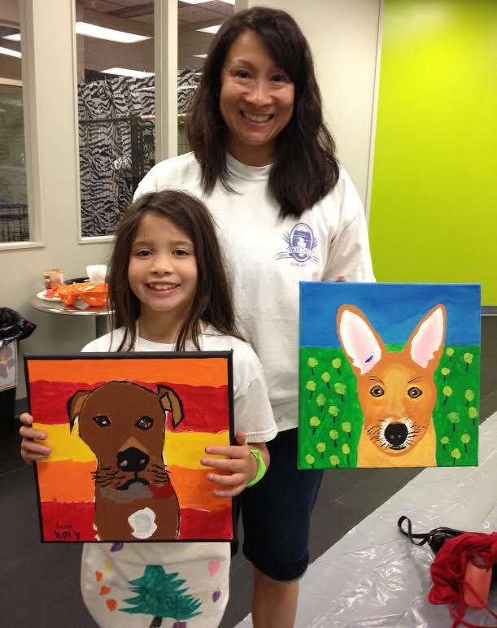
GET CREATIVE!
We welcome your ideas- ANYTHING that excites you to help support the animals!
From tech to training, fundraising to fashion (yes! volunteers may design t-shirts!), bake sales, fitness classes, art auctions… we depend on YOUR skills and ideas to propel our crew to great heights.
WE ALWAYS NEED volunteers work from home processing applications, coordinating events and foster care, writing newsletters, and many other things so...
Don’t be afraid to to share what YOU think might be your best talent...you just may be the missing piece we’ve been seeking!
Nothing happens at Motley Zoo WITHOUT volunteers.
FUNDRAISE & DONATE SKILLS: volunteer@motleyzoo.org

Slide 21
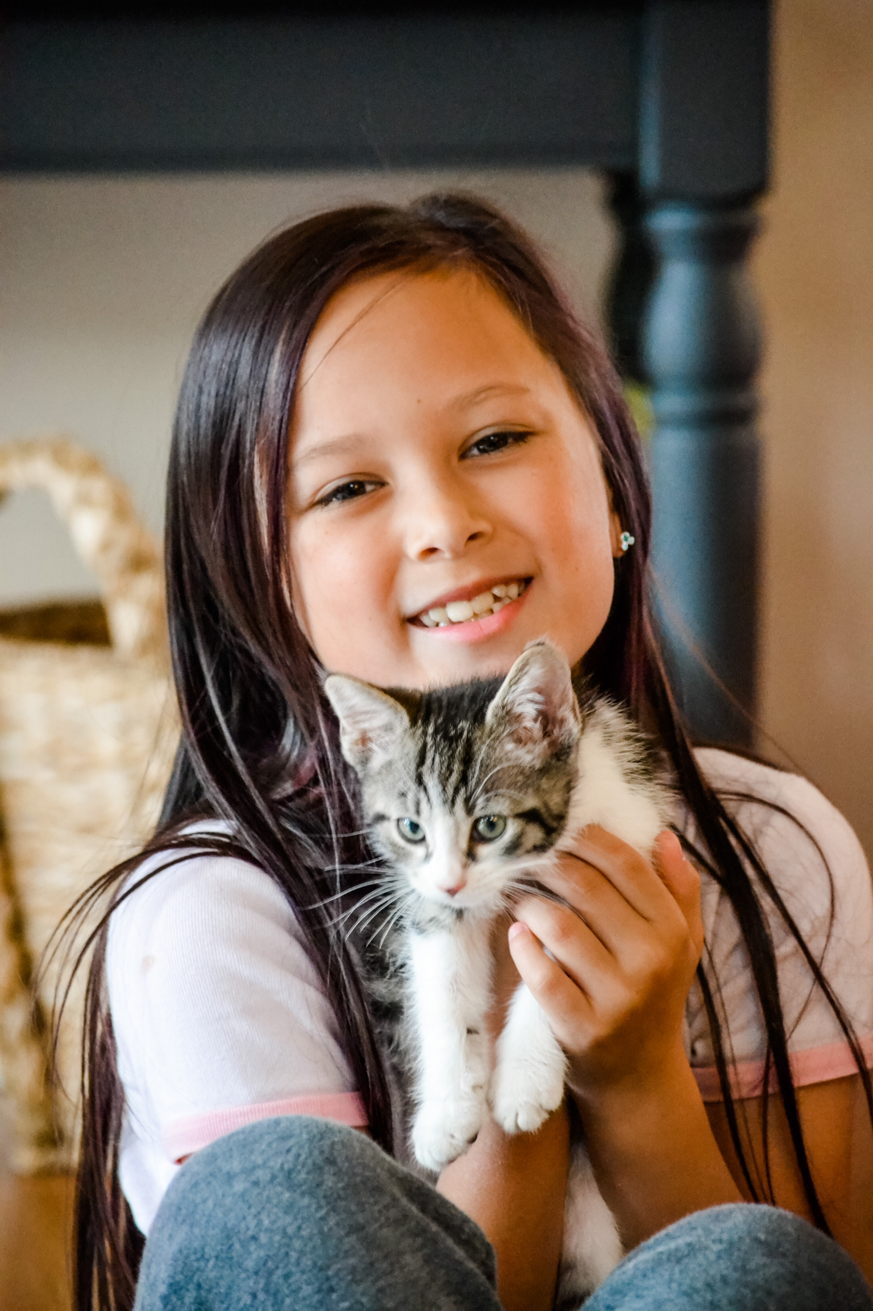
NEXT STEPS...
We hope that you have been inspired to get involved with an aspect of Motley Zoo Animal Rescue that feels like a good fit for YOU.
Click the links below and say “hello”! An automated response will send an application instantly to your inbox (check your spam)!
I want to ADOPT or FOSTER and perhaps VOLUNTEER:
adopt@motleyzoo.org
I want to FOSTER and perhaps VOLUNTEER:
foster@motleyzoo.org
I just want to VOLUNTEER:
volunteer@motleyzoo.org
After you submit your application, one of our coordinators will contact you regarding further required training and help guide you to your future as a Rescue Rock Star!!
THANK YOU! ROCK ON, RESCUE ON!

